Slide 1
INTRO to DATA SCIENCE Cluster ANALYSIS

Slide 2
I. cluster analysis II. The K-means Algorithm III. Choosing K IV. DBSCAN Clustering
agenda

Slide 3
I. cluster analysis
INTRO TO DATA SCIENCE

Slide 4
Cluster analysis
continuous categorical
supervised ??? ???
unsupervised ??? ???

Slide 5
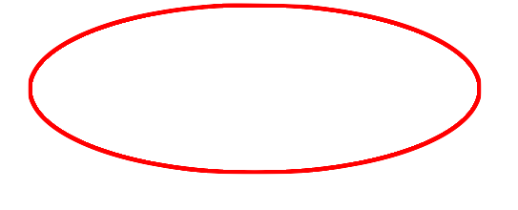
Logistic regression
continuous categorical
supervised regression classification
unsupervised dimension reduction clustering

Slide 6
Cluster analysis
Q: What is a cluster?

Slide 7
Cluster analysis
Q: What is a cluster?
A: A group of similar data points.
Notes:
Similar is a loaded word here!

Slide 8
Cluster analysis
Q: What is a cluster?
A: A group of similar data points.
The concept of similarity is central to the definition of a cluster, and therefore to cluster analysis.
In general, greater similarity between points leads to better clustering.

Slide 9
Cluster analysis
Q: What is the purpose of cluster analysis?

Slide 10
Cluster analysis
Q: What is the purpose of cluster analysis?
A: To enhance our understanding of a dataset by dividing the data into groups.
Clustering provides a layer of abstraction from individual data points.
The goal is to extract and enhance the natural structure of the data
Notes:
Useful for understanding, inference, platform for further analysis

Slide 11
Cluster analysis
Clustering can be useful in a wide variety of domains, including genetics, consumer internet and business.
Notes:
Useful for understanding, inference, platform for further analysis
http://www-users.cs.umn.edu/~kumar/dmbook/ch8.pdf Helpful examples

Slide 12
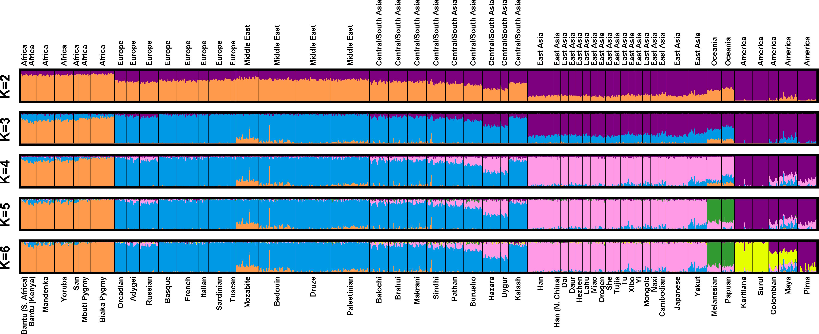
Cluster analysis
Clustering can be useful in a wide variety of domains, including genetics, consumer internet and business.
Notes:
http://www-users.cs.umn.edu/~kumar/dmbook/ch8.pdf

Slide 13
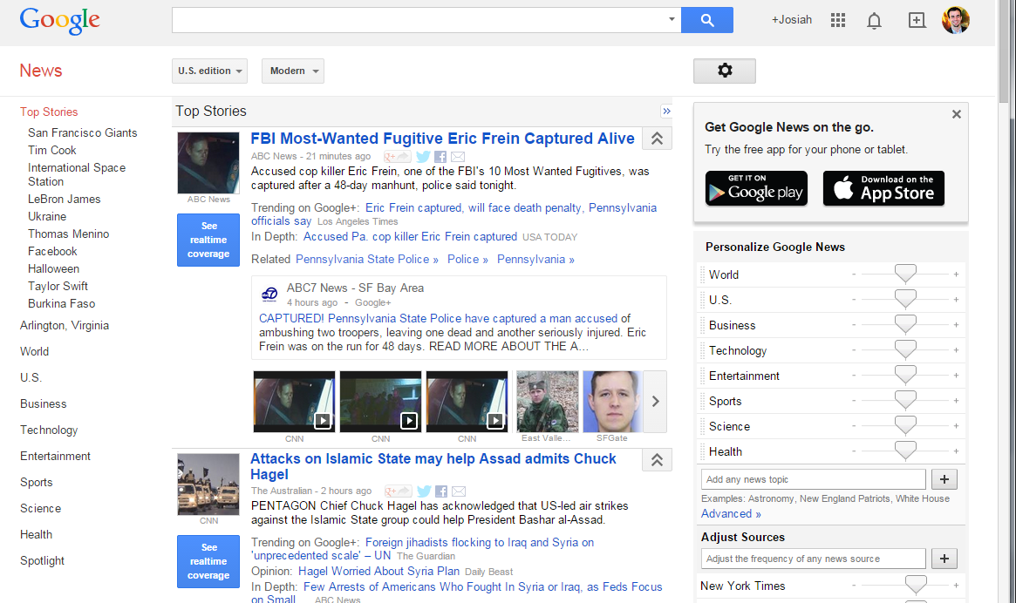

Cluster analysis
Clustering can be useful in a wide variety of domains, including genetics, consumer internet and business.
Notes:
Useful for understanding, inference, platform for further analysis

Slide 14

Cluster analysis
Clustering can be useful in a wide variety of domains, including genetics, consumer internet and business.
http://i.huffpost.com/gen/1563531/thumbs/o-GROCERY-STORE-facebook.jpg
Notes:
Useful for understanding, inference, platform for further analysis

Slide 15
Cluster analysis
There are many kinds of classification procedures. For our class, we will be focusing on K-means clustering, which is one of the most popular clustering algorithms.
K-means is an iterative method that partitions a data set into k clusters.
Notes:
Not all clustering algorithms separate the data set into mutually exclusive partitions (e.g., Agglomerative Hierarchical Clustering).

Slide 16
II. K-means clustering
INTRO TO DATA SCIENCE

Slide 17
K-means clustering
Q: How does the algorithm work?

Slide 18
The basic K-means algorithm
1) choose k initial centroids (note that k is an input)
2) for each point:
- assign point to nearest centroid
3) recalculate centroid positions
4) repeat steps 2-3 until stopping criteria met
Notes:
** write this on the whiteboard **

Slide 19
The basic K-means algorithm
1) choose k initial centroids (note that k is an input)
2) for each point:
- find distance to each centroid
- assign point to nearest centroid
3) recalculate centroid positions
4) repeat steps 2-3 until stopping criteria met
x₁
x₂
Notes:
** write this on the whiteboard **

Slide 20
The basic K-means algorithm
1) choose k initial centroids (note that k is an input)
2) for each point:
- find distance to each centroid
- assign point to nearest centroid
3) recalculate centroid positions
4) repeat steps 2-3 until stopping criteria met
x₁
x₂
Notes:
** write this on the whiteboard **

Slide 21
The basic K-means algorithm
1) choose k initial centroids (note that k is an input)
2) for each point:
- find distance to each centroid
- assign point to nearest centroid
3) recalculate centroid positions
4) repeat steps 2-3 until stopping criteria met
x₁
x₂
Notes:
** write this on the whiteboard **

Slide 22
The basic K-means algorithm
1) choose k initial centroids (note that k is an input)
2) for each point:
- find distance to each centroid
- assign point to nearest centroid
3) recalculate centroid positions
4) repeat steps 2-3 until stopping criteria met
x₁
x₂
Notes:
** write this on the whiteboard **

Slide 23
The basic K-means algorithm
1) choose k initial centroids (note that k is an input)
2) for each point:
- find distance to each centroid
- assign point to nearest centroid
3) recalculate centroid positions
4) repeat steps 2-3 until stopping criteria met
x₁
x₂
Notes:
** write this on the whiteboard **

Slide 24
The basic K-means algorithm
1) choose k initial centroids (note that k is an input)
2) for each point:
- find distance to each centroid
- assign point to nearest centroid
3) recalculate centroid positions
4) repeat steps 2-3 until stopping criteria met
x₁
x₂
Notes:
** write this on the whiteboard **

Slide 25
The basic K-means algorithm
1) choose k initial centroids (note that k is an input)
2) for each point:
- find distance to each centroid
- assign point to nearest centroid
3) recalculate centroid positions
4) repeat steps 2-3 until stopping criteria met
x₁
x₂
Notes:
** write this on the whiteboard **

Slide 26
The basic K-means algorithm
1) choose k initial centroids (note that k is an input)
2) for each point:
- find distance to each centroid
- assign point to nearest centroid
3) recalculate centroid positions
4) repeat steps 2-3 until stopping criteria met
x₁
x₂
Notes:
** write this on the whiteboard **

Slide 27
The basic K-means algorithm
1) choose k initial centroids (note that k is an input)
2) for each point:
- find distance to each centroid
- assign point to nearest centroid
3) recalculate centroid positions
4) repeat steps 2-3 until stopping criteria met
x₁
x₂
Notes:
** write this on the whiteboard **

Slide 28
Step 1 – Choosing initial centroids
Q: How do you choose the initial centroid positions?
Notes:
Note: hierarchical clustering is comp expensive, but does not require initial choice of centroids

Slide 29
Step 1 – Choosing initial centroids
Q: How do you choose the initial centroid positions?
A: There are several options:
- randomly (but may yield divergent behavior)
- perform alternative clustering task, use resulting centroids as
initial k-means centroids
- start with global centroid, choose point at max distance, repeat (but might select outlier)
Notes:
Dealing with outliers in clustering is another topic (remove, don’t remove, detection)

Slide 30
Step 2 – Assess similarity
Q: How do you determine which centroid a given point is most similar to?

Slide 31
Step 2 – Assess similarity
Q: How do you determine which centroid a given point is most similar to?
The similarity criterion is determined by the measure we choose.
In the case of k-means clustering, the similarity metric is the Euclidian distance:

Slide 32
Step 3 – Recomputing the Center
Q: How do we re-compute the positions of the centers at each iteration of the algorithm?
A: By calculating the centroid (i.e., the geometric center)
This is done by taking the average of each index of vectors
Centroid of [1, 4, 2] and [6, 4, 2] is
[(1 + 6) / 2, (4 + 4) / 2, (2 + 2) / 2] == [3.5, 4, 2]
Notes:
Results should be pretty consistent for various choices of metric.

Slide 33
Step 4 – convergence
We iterate until some stopping criteria are met; in general, suitable convergence is achieved in a small number of steps.
Notes:
4 or 5 steps is usual

Slide 34
III. Cluster validation
INTRO TO DATA SCIENCE

Slide 35
Cluster validation
In general, k-means will converge to a solution and return a partition of k clusters, even if no natural clusters exist in the data.

Slide 36
Cluster validation
In general, k-means will converge to a solution and return a partition of k clusters, even if no natural clusters exist in the data.
We will look at two validation metrics useful for partitional clustering, cohesion and separation.
Notes:
Note: these are unsupervised validation metrics (don’t depend on external info)
There is a duality between unsup validation metrics & objective funcs

Slide 37
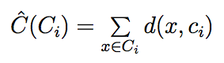
Cluster validation
Cohesion measures clustering effectiveness within a cluster.
Notes:
Sum of inter-cluster distances to centriod

Slide 38
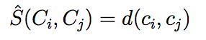
Cluster validation
Cohesion measures clustering effectiveness within a cluster.
Separation measures clustering effectiveness between clusters.
Notes:
Distance between centroids in different clusters

Slide 39
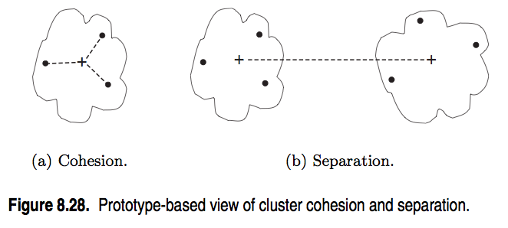
Cluster validation
source: http://www-users.cs.umn.edu/~kumar/dmbook/ch8.pdf
Notes:
In general, want cohesion to be low & separation to be high

Slide 40
Silhouette coefficient
One useful measure than combines the ideas of cohesion and separation is the
silhouette coefficient
Notes:
numerator = daylight between clusters
denom = largest length scale

Slide 41
Silhouette coefficient
The silhouette coefficient can take values between -1 and 1.
In general, we want separation to be high and cohesion to be low. This corresponds to a value of SC close to +1.
A negative silhouette coefficient means the cluster radius is larger than the space between clusters, and thus clusters overlap.
Notes:
(in k-means, this is pathological…overlapping clusters means pts are not assigned to nearest centroids!)

Slide 42
Cluster validation
Ultimately, cluster validation and clustering in general are suggestive techniques that rely on human interpretation to be meaningful.

Slide 43
STRENGTHS AND WEAKNESSES
Strengths:
K-means is a popular algorithm because of its computational efficiency and simple and intuitive nature.

Slide 44
STRENGTHS AND WEAKNESSES
Strengths:
K-means is a popular algorithm because of its computational efficiency and simple and intuitive nature.
Weaknesses:
However, K-means is highly scale dependent, and is not suitable for data with widely varying shapes and densities.

Slide 45
IV. DBscan clustering
INTRO TO DATA SCIENCE

Slide 46
Dbscan clustering
DBSCAN: Density-Based Spatial Clustering of Applications with Noise
For DBSCAN, clusters are areas of high density separated by areas of low density.

Slide 47
Dbscan clustering
DBSCAN Algorithm:
1. Choose “epsilon” and “min_samples” 2. Pick an arbitrary point, and check if there are at least “min_samples” points within the distance “epsilon”
If yes, add those points to the cluster and check each of the new points
If no, choose another arbitrary point to start a new cluster
3. Stop once all points have been checked
Visualization: Uniform Points

Slide 48
Dbscan clustering
DBSCAN Advantages:
Clusters can be any shape or size
No need to choose the number of clusters
DBSCAN Disadvantages:
More parameters to tune
Doesn’t work with clusters of varying density
Note: Not every point is necessarily assigned to a cluster!

